Slide 1
WINDOW FUNCTIONS
Presented By: SIRAVENI SHIVANI

Slide 2
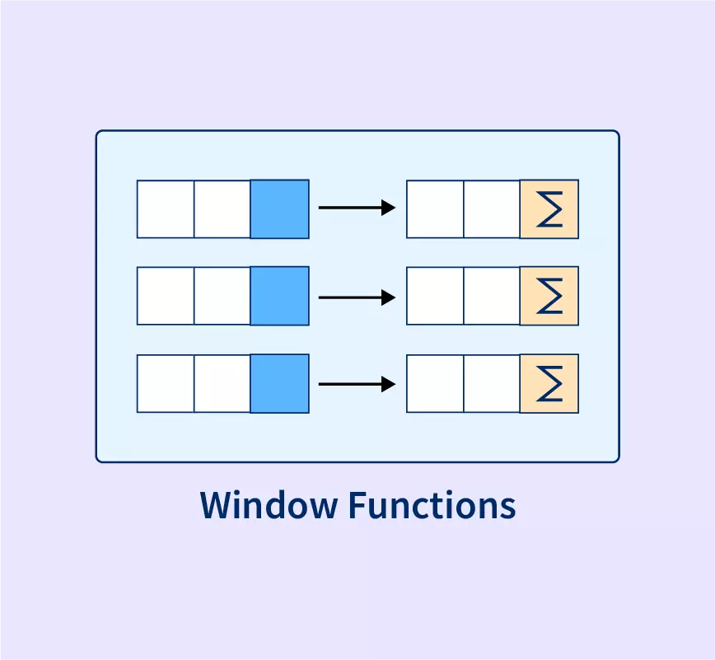
Window Functions
What are Window Functions?
Window Functions perform calculations across a group of rows related to the current row without reducing the number of rows.

Slide 3
Window Functions
SELECT
column_name,
function_name() OVER (
PARTITION BY
column_name
ORDER BY column_name
) AS alias_name
FROM table_name;
General Syntax
<window function_name>()
OVER(
PARTITION BY <expression>
ORDER BY <expression> [ASC|DESC ]
)

Slide 4
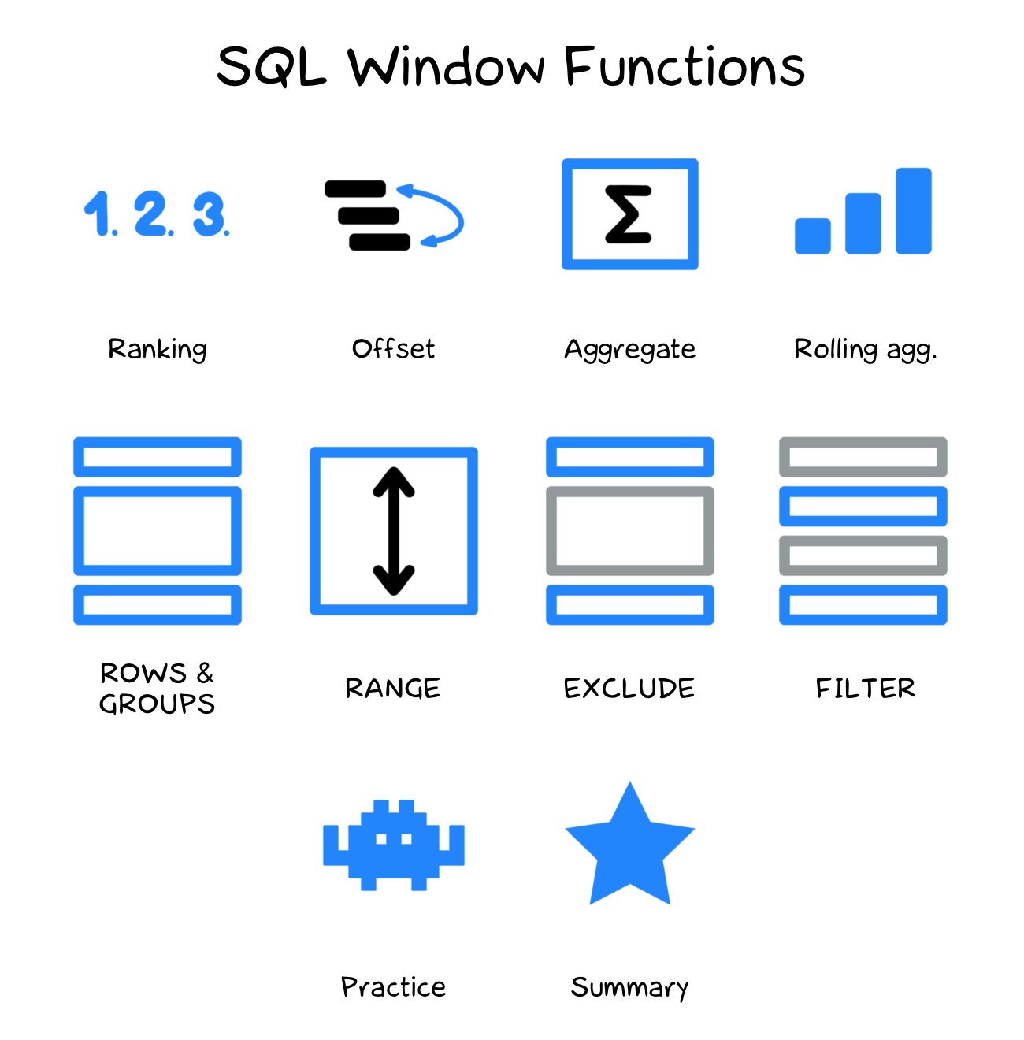
Window Functions
TYPES OF WINDOW FUNCTIONS
Window functions
RANKING VALUES AGGRAGTE
ROW_NUMBER()
RANK()
DENSE_RANK()
LAG()
LEAD()
SUM()
AVG()
MIN()
MAX()
COUNT()

Slide 5
Window Functions
RANKING
Ranking functions assign a sequential or relative rank to rows according to a specified order while preserving all records in the result set.

Slide 6
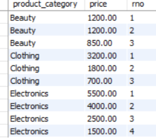

Window Functions
ROW_NUMBER()
Assigns a unique sequential number to each row.
SELECT
column_name,
ROW_NUMBER() OVER (
PARTITION BY
column_name
ORDER BY column_name
) AS alias_name
FROM table_name;

Slide 7
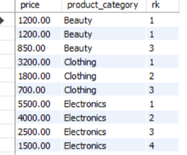
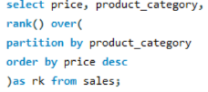
Window Functions
RANK()
Assigns the same rank to ties and skips the next rank.
SELECT
column_name,
RANK() OVER (
PARTITION BY
column_name
ORDER BY column_name
) AS alias_name
FROM table_name;

Slide 8
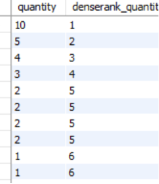
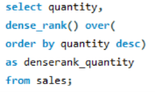
Window Functions
DENSE_RANK()
Assigns the same rank to ties without skipping ranks.
SELECT
column_name,
DENSE_RANK() OVER (
PARTITION BY
column_name
ORDER BY column_name
) AS alias_name
FROM table_name;

Slide 9
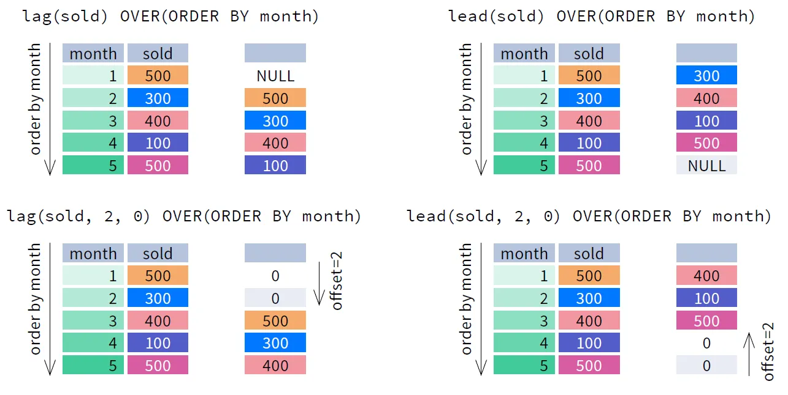
Window Functions
VALUE
Value Functions retrieve values from previous or next rows, making them useful for comparisons, trend analysis, and sequential data analysis.

Slide 10
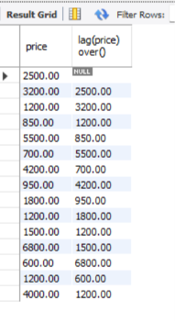

Window Functions
LAG()
Retrieves the previous row's value.
SELECT
column_name,
LAG() OVER ( )
FROM table_name;

Slide 11
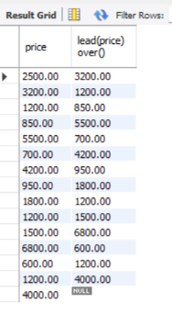

Window Functions
LEAD()
Retrieves the next row's value.
SELECT
column_name,
LEAD() OVER ()
FROM table_name;

Slide 12
Window Functions
AGGREGATE FUNCTIONS()
Perform calculations across a window of rows without reducing the number of rows.
SELECT
column_name,
AGGREGATE_FUNCTION() OVER (
PARTITION BY
column_name
ORDER BY column_name
) AS alias_name
FROM table_name;
<aggregate_function> = SUM(), AVG(), MIN(), MAX(), COUNT()
OVER(
PARTITION BY <expression>
ORDER BY <expression> [ASC|DESC ]
)

Slide 13
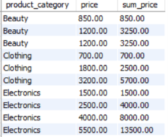
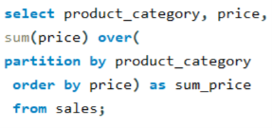
Window Functions
SUM()
Calculates the total of a numeric column while preserving all rows in the result.
SELECT
column_name,
AGGREGATE_FUNCTION () OVER (
PARTITION BY
column_name
ORDER BY column_name
) AS alias_name
FROM table_name;

Slide 14
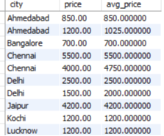
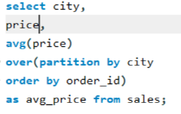
Window Functions
AVG()
Calculates the average of a numeric column while preserving all rows in the result.
SELECT
column_name,
AGGREGATE_FUNCTION () OVER (
PARTITION BY
column_name
ORDER BY column_name
) AS alias_name
FROM table_name;

Slide 15
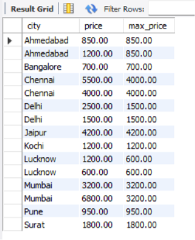
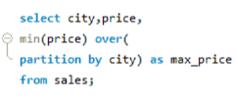
Window Functions
MIN()
Returns the minimum value in a window while preserving all rows in the result.
SELECT
column_name,
AGGREGATE_FUNCTION () OVER (
PARTITION BY
column_name
ORDER BY column_name
) AS alias_name
FROM table_name;

Slide 16
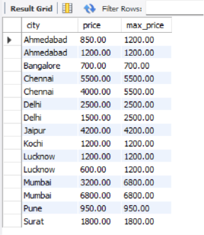

Window Functions
MAX()
Returns the maximum value in a window while preserving all rows in the result.
SELECT
column_name,
AGGREGATE_FUNCTION () OVER (
PARTITION BY
column_name
ORDER BY column_name
) AS alias_name
FROM table_name;

Slide 17
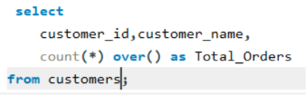
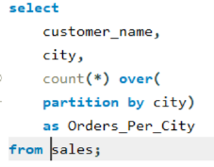
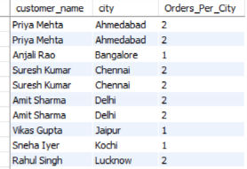
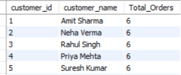
Window Functions
Count()
Returns the total number of rows in a window while preserving all rows in the result.
Count() with partition
Count() without partition

Slide 18
THANK YOU

